Slide 1
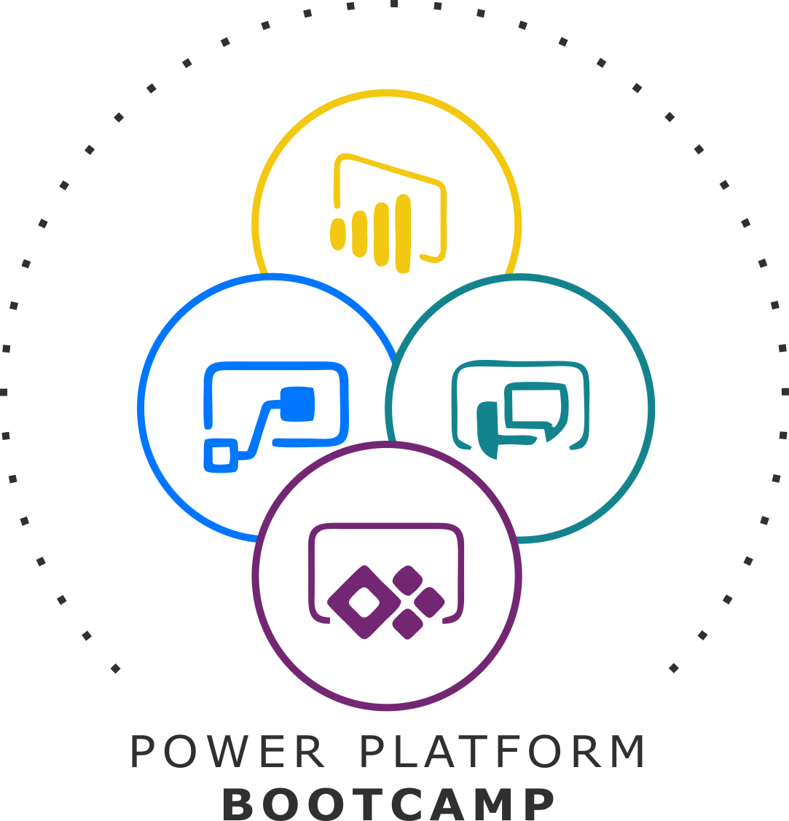


GLOBAL POWER PLATFORM BOOTCAMP
Organized Globally, Held Locally

Slide 2
Governance and Analytics for the Power platform
Ridhi Jain & Shweta Tuli

Slide 3

Ridhi Jain
An Office 365 expert with 4+ years of experience.
Part of enterprise content management COE team
Majorly focuses on research and development of new accelerators on the digital transformation and platform modernization using O365 services
Shweta Tuli
An Office 365 expert with 3+ years of experience.
Part of enterprise content management COE team
Majorly focuses on research and development of new accelerators using O365 services.
Delivers sessions in organization for various Office 365 offered services

Slide 4
Session Agenda
How secure is your tenant?
Environments
Data Loss Prevention Policies (DLP)
Tracking activity and logs on tenant
Monitoring
Audit Logging and search
Power Platform Analytics
Center of Excellence
COE Starter Kit

Slide 5
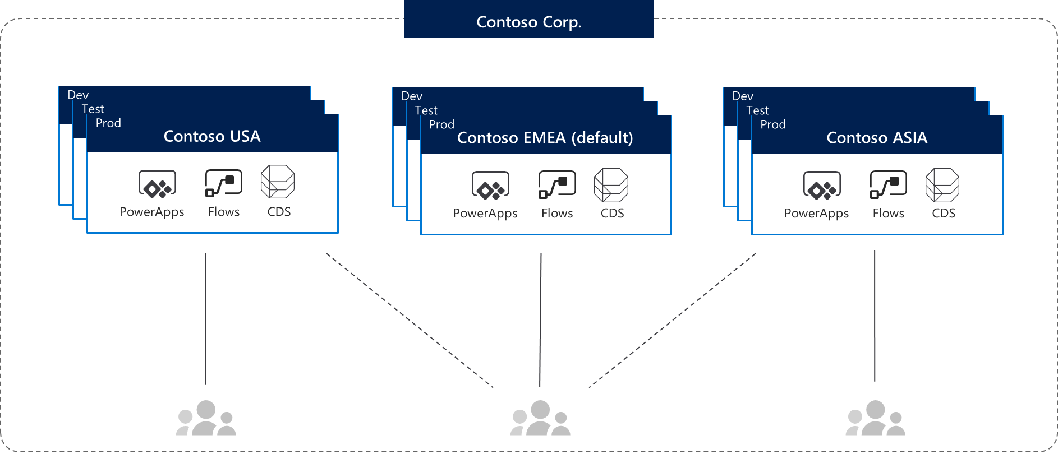
Environments
Trial
Expires after 30 days, limit 1 per user
Developer
Developer environments cannot be shared with nor affect other users.
Sandbox
Non-production environment enables some additional options like copy and reset.
Default
Every tenant has one default environment.
Production
Non-expiring full environment
Types Of Environments
Environments are containers that administrators can use to manage apps, flows, connections, and other assets; along with permissions to allow organization users to use the resources
Azure AD Tenant
Environment Security Roles
Environment Admin
Can perform all administrative actions on an environment.
Environment Maker
Can create resources in an environment but cannot make administrative actions on the environment itself.
End User
Can access assets like apps and flow buttons that are shared with them but cannot create assets themselves.
Environments

Slide 6
Demo: Managing Environments

Slide 7
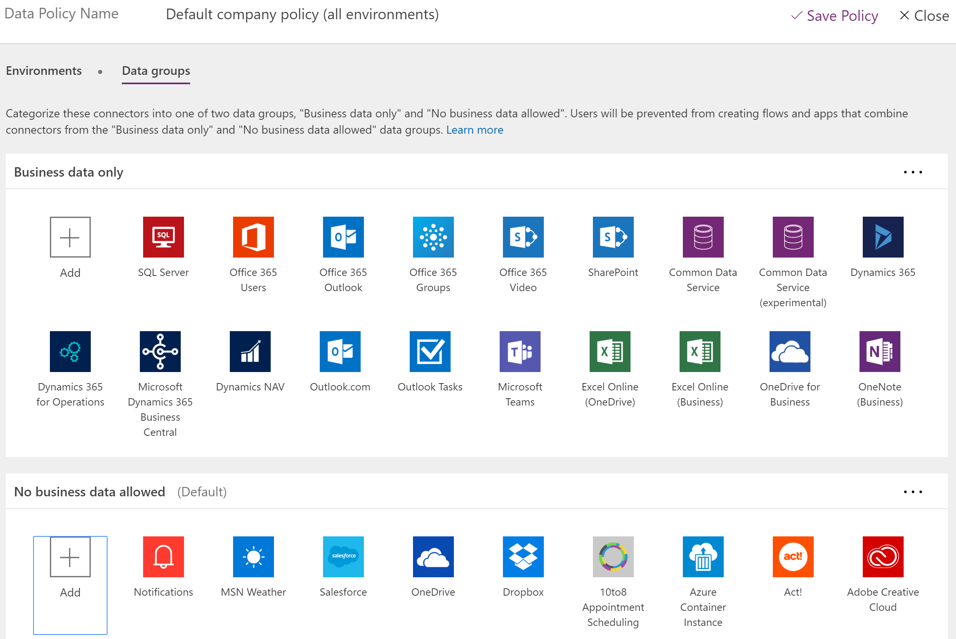



Data Loss Prevention(DLP)
Prevents organization’s critical data to be shared to the audience that shouldn’t have access to it.
Identify
Identification of critical data based upon connectors and data groups
Analyse
Connectors are classified as either Business Data only or No Business Data allowed (Data Groups)
Permissions based policy applications
Tenant Admins
Environment admins
Protect

Slide 8
Demo: Data Loss Prevention Policies

Slide 9
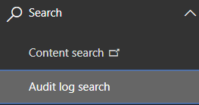
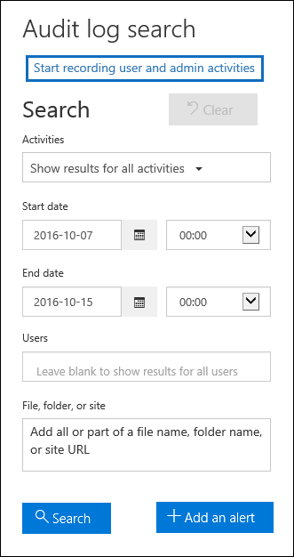
Auditing
Logs and Analytics with Activity Tracking
Pre-requisites
Must have an Office 365 E3 or greater license
Navigate to “Security and Compliance” (protection.office.com) Admin Center’s Search section to turn on audit logging before proceeding.
Admins can search the audit log for activities that were performed across the tenant within the previous 90 days.
Warnings and Information
Any activity performed before turning on the settings will not be recorded in Audit Logs for the tenant.
Turn On
Search
Export
Admins will be able to view and enable/disable this settings only after the granting the desirable permissions
Notes:
Office provides an API to query this data, which is currently used by many SIEM vendors to use the Activity Logging data for reporting

Slide 10
Demo: Audit Log Search | Security and Compliance Center

Slide 11
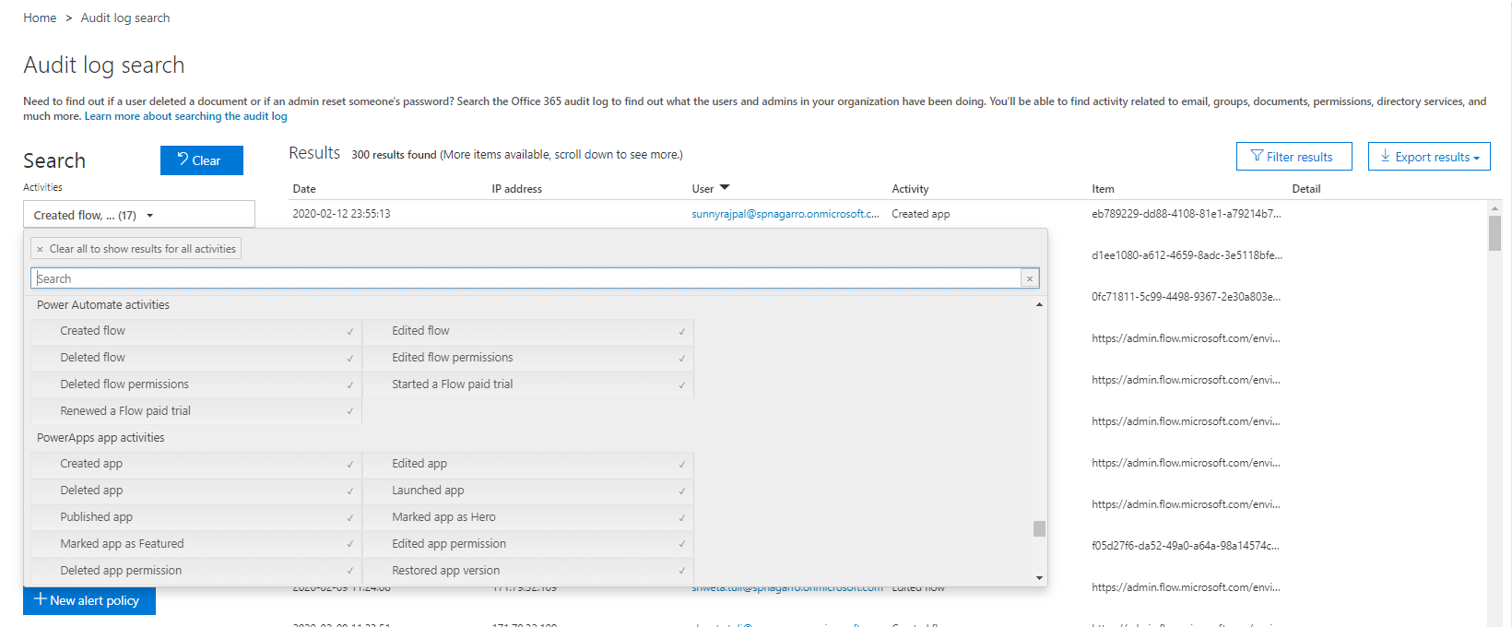
Select activities to audit from various PowerApps and Power Automate
Results can be filtered by clicking to open a data table view. Users can type in keywords and can sort the results for sortable columns
The audit log results can be exported for further investigation by either saving or downloading.
Audit Log Search results in a detailed view

Slide 12
Logs & analytics – see what’s happening
1. PowerApps and Flow logs available at https://protection.office.com 2. Admin analytics available at https://admin.powerplatform.microsoft.com/
Tenant and environment level analytics
Available from Power Platform admin center
Access is available for admins
Data is stored for 28 days
Data is refreshed daily ( 3 hours span)
Capacity Management
Common Data Service
Microsoft Flow
PowerApps

Slide 13
Demo: Power Platform Analytics

Slide 14
Center of Excellence
COE Starter Kit
COE Responsibilities
Download here now https://aka.ms/coestarterkit
Administration & Governance
Nurture
Support
Operations
Step | Scenario | Toolkit Component
Secure​ | DLP Editor | Canvas App - DLP Editor​
Monitor​ | Flow templates to collect data into CDS​ Power BI Dashboards​ | CDS Entities​: Environments, Apps, Flows… Flow - Sync resources template​ Flow - Sync audit logs Power BI Dashboard Custom Connector for Office 365 Audit Logs
Alert & Action​ | Maker and Admin notification via Flow templates (Compliance request)​ Admin Model Driven App facilitates app audit process​ | Canvas App - Developer Compliance Center​ Flow - Compliance detail request​ Model Driven App​ - Business Process Flow for Auditing resources
Nurture​ | App catalog​ Welcome email, Internal community channel links​ | Canvas App - App Catalog Flow - Welcome Email​
Notes:
Start simple and grow…

Slide 15
Demo: COE | Core Components

Slide 16
Any Questions?

Slide 17
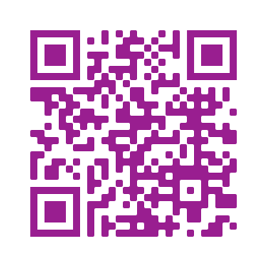
Please fill out the survey! & Win Swags!!
https://www.powerplatformbootcamp.com/survey

Slide 18
Thank You For Attending

